Slide 1
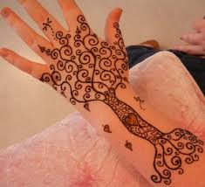
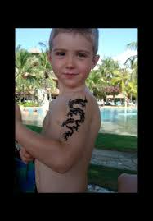
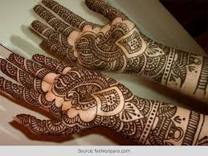
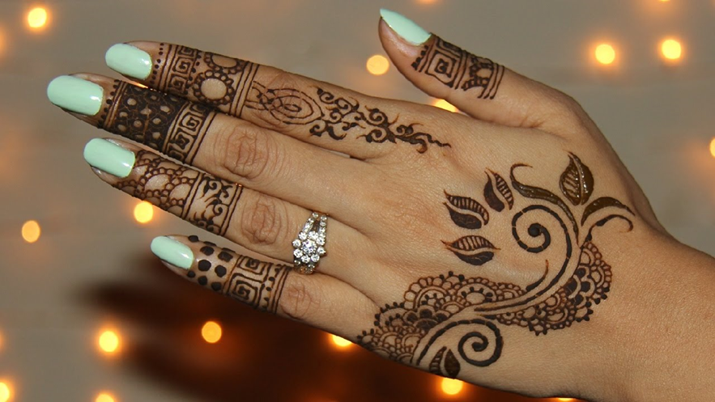
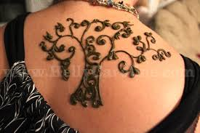
Welcome to Arabic Level I by Kurzban

Slide 3
Review of previous letters
One way connectors and two way connectors & greetings.

Slide 4
Characteristics of Arabic Henna Designs:
The unique characteristics of Arabic mehndi design include:
Free flowing
Scattered patterns
External Additive and color

Slide 5
Lesson 3: الدرس الثالث
Objectives:
Identify long and Short Vowels
Arabic alphabet: one & two- way connectors
Practice
Summary
Review Lesson 2

Slide 6
Lesson 3: Identifying short vowels
Arabic script is similar to (Short Message Service) SMS messages in that both types of writing leave out many of the vowels.
Short vowels are written above and below the letters

Slide 7
Identifying short vowels
Ba Bi Bu
بُ ِب َب

Slide 8
Short Vowels
A dash above the letter ( ) is pronounced as a short “a” following the letter.
This vowel is called fatha

Slide 9
Short Vowels
A dash below the letter ( ) is pronounced as a short “i” following the letter.
This vowel is called kasra

Slide 10
Short Vowels
A comma shaped above the letter ( ) is pronounced as a short “u” following the letter.
This vowel is called damma

Slide 11
Mini practice
Practice saying these letters with their vowels.
1] بِ 3] ثُ
2] نَ 4] تِ

Slide 12
Mini practice
Practice saying these letters with their vowels.
1] دَ 3] ذِ
2] رُ 4] زِ

Slide 13
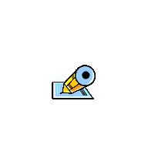
Short Vowels continue
ب ت ث ن ي
Fatha for all above letters
ب ت ث ن ي
Kasra for all above letters
ب ت ث ن ي
Damma for all above letters

Slide 14
Summary
Examine these sentences and identify the vowels that we have discussed by circling them
فَتْحَةٌ
كَسْرَةٌ
ضَمَّةٌ

Slide 15
Arabic Alphabet: practice connecting them
ن +ي =
ب +ن =
ي +ب+ث =
ب + ي +ت =

Slide 16
Let’s practice
و +ر +د =
ر + ب +و =
ا + ب +ن =
ب +ر +د =
Remember: Your strokes should go from top to bottom and from right to left.

Slide 17
Summary
Examine these sentences and identify the vowels that we have discussed by circling them
يَقْرَأُ الْوَلَدُ كِتَاْبَه

Slide 18
Review
Flash card for lesson 2

